Slide 1
Introduction to Computers
Jeremiah Kafakoma

Slide 2
Healthy and Safety Issues
When discussing safety issues with regard to Computers, lets break them into three general areas:
Computer components
Natural elements
Work environment
Computer Components
Computers use electricity and be aware it can hurt or kill you.
The first rule when working inside a computer is to always make sure its powered off.

Slide 3
Mains electricity
Can cause anything from unpleasant to fatal shock!
Usually only occurs inside power supplies
Most computers operate at 12v or less
Ensure mains is OFF and UNPLUGGED
Wait for capacitors in power supplies to discharge.
Hot components
Some components inside a PC are hot enough to cause burns.
Turn off power and wait for components to cool down before handling.

Slide 4
Natural elements
Computers should always be operated in cool environments away from direct sunlight and water sources.
Dirt and dust act as great insulators, trapping heat inside components. When components runs hotter than they should, they have a greater chance of breaking down faster.
Work environment
It is estimated that more than 2.5% of all the lead a poisonous substance today is a result of consumer electronics components.
They contains hazardous substances, many states require that they be disposed of as hazardous waste for example Monitors contain several carcinogens and phosphors as well as mercury and lead.

Slide 5
Lifting and carrying
Some computer equipment is heavy.
Get proper manual handling training and get assistance if necessary.
Trip hazard
The biggest cause of accidents
It is very easy to put something on the floor and then forget about it.
Keep work area floors clear and tidy.
Move anything that might be a hazard.

Slide 6
Computer components are expensive and delicate.
Particularly susceptible to electric shocks
Electrostatic discharge
Discharge electrostatic by touching a suitable earth point
particularly if you are wearing manmade fibre clothing
Wear an electrostatic discharge wrist strap
E.g. http://tinyurl.com/6528t3c
Or use a full anti-static kit, with wrist strap and mat
E.g. http://tinyurl.com/62c65w2

Slide 7
Power surge
Caused by plugging or unplugging components when power is on
Turn off power and unplug before working inside a PC
Note: Powering down a PC from Windows does NOT switch it of completely
There is still power on the motherboard and inside the PSU
You may see a light on the back of the PSU or on the motherboard, but if not, do not assume that there is no power.
Switch off at the wall and unplug.

Slide 8
What Is a Computer?
An electronic device, operating under the control of instructions stored in its own memory, that can:
Accept data (input)
Process the data according to specified rules (process)
Produce results (output)
Store the results (storage) for future use

Slide 9
The Components of a Computer
There are six primary components of a computer:
Input devices,
Processor (control unit and arithmetic/logic unit),
Memory,
Output devices,
Storage devices,
Communications devices
The processor, memory, and storage devices are housed in a box-like case called the system unit
A peripheral is a device that connects to the system unit and is controlled by the processor in the computer

Slide 10
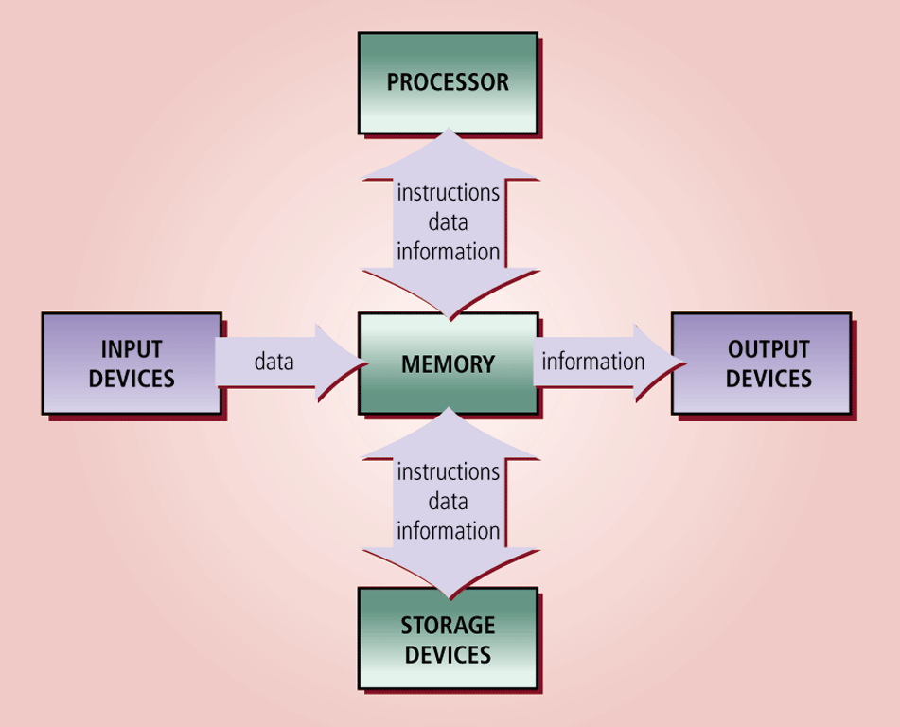

Slide 11
Personal Computers and Mobile Devices
A personal computer is a computer that can perform all of its input, processing, output, and storage activities by itself
A mobile device is a computing device small enough to hold in your hand

Slide 12
Input Devices
An input device is any hardware component that allows you to enter data and instructions into a computer
A keyboard is an input device that contains keys users press to enter data and instructions into the computer
A stylus is a small metal or plastic device that looks like a tiny ink pen, but uses pressure instead of ink
A mouse is a pointing device that fits comfortably under the palm of your hand
Most notebook computers have a touchpad, a small, flat, rectangular pointing device

Slide 13
System Unit
The system unit is a case that contains electronic components of the computer used to process data
The processor (CPU) interprets and carries out the basic instructions that operate a computer
Arithmetic/logic unit
Memory (RAM) consists of electronic components that store instructions waiting to be executed and data needed by those instructions

Slide 14
Output Devices
Output devices are hardware components that convey information to one or more people
A printer is an output device that produces text and graphics on a physical medium such as paper
Ink-jet printer
Photo printer
Laser printer
Multifunction peripheral (all-in-one device)

Slide 15
Storage Devices
A storage device is the computer hardware that records and/or retrieves items to and from storage media
A hard disk is a storage device that contains one or more inflexible, circular platters that use magnetic particles to store data, instructions, and information
Sectors
Tracks

Slide 16
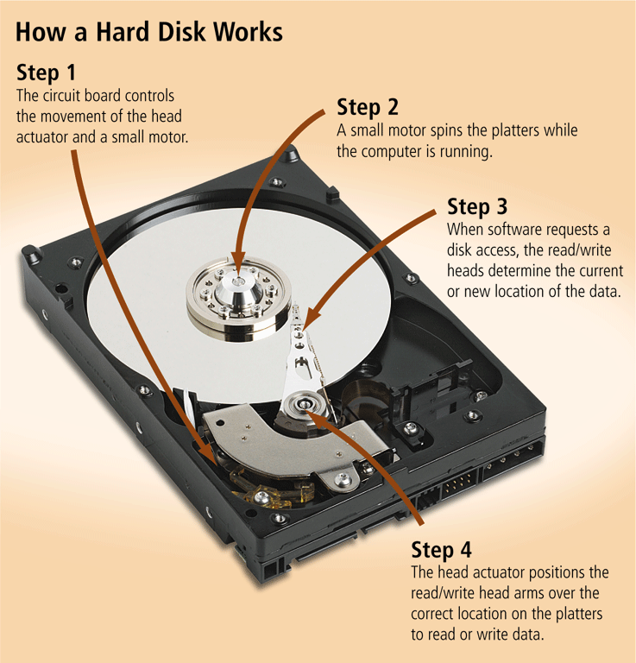

Slide 17
An external hard disk is a separate freestanding hard disk that connects with a cable to a port on the system unit or communicates wirelessly
A removable hard disk is a hard disk that you insert and remove from a drive
Flash memory is a type of memory that can be erased electronically and rewritten
Solid state media
A solid state drive (SSD) is a storage device that typically uses flash memory to store data, instructions, and information

Slide 18
Communications Devices
A communications device is a hardware component that enables a computer to send (transmit) and receive data, instructions, and information to and from one or more computers or mobile devices
Transmission media

Slide 19
How to Purchase a Desktop Computer
Determine the specific software to use on your computer
Know the system requirements of the operating system
Look for bundled software
Avoid buying the least powerful computer available
Consider upgrades to the mouse, keyboard, monitor, printer, microphone, and speakers

Slide 20
How to Purchase a Desktop Computer
Determine whether to use a broadband or dial-up connection to access the Internet
Use a worksheet to compare computers, services, and other considerations
If you are buying a new computer, you have several purchasing options: buying from a school bookstore, a local computer dealer, a local large retail store, or ordering by mail via telephone or the Web
If you are buying a used computer, stay with name brands such as Dell, Apple, HP, and Gateway
If you have a computer and are upgrading to a new one, then consider selling or trading in the old one

Slide 21
How to Purchase a Desktop Computer
Be aware of hidden costs
Consider more than just price
Avoid restocking fees
Use a credit card to purchase a new computer
Consider purchasing an extended warranty or service plan

Slide 22
How to Purchase a Notebook Computer
Determine which computer fits your mobile computing needs
Purchase a notebook computer with a sufficiently large screen
Experiment with different keyboards, pointing devices, and digital pens
Make sure the notebook computer you purchase has an optical disc drive
If necessary, upgrade the processor, memory, and disk storage at the time of purchase
The availability of built-in ports and slots and a USB hub on a notebook computer is important

Slide 23
How to Purchase a Notebook Computer
If you plan to use your notebook computer for note-taking at school or in meetings, consider a convertible Tablet PC
If you purchase a Tablet PC, determine whether you require multi-touch technology
Purchase a notebook computer with an integrated Web cam
Check with your wireless carrier to see if it offers netbooks for sale
Purchase a notebook computer with a built-in wireless network connection

Slide 24
How to Purchase a Notebook Computer
If you plan to use your notebook computer for long periods without access to an electrical outlet, purchase a second battery
Purchase a well-padded and well-designed carrying case
If you plan to connect your notebook computer to a video projector, make sure the notebook computer is compatible with the video projector
For improved security and convenience, consider a fingerprint scanner
Review the docking capabilities of the Tablet PC

Slide 25
Types of Computers
General purpose computers
Mainframe
Supercomputers
Minicomputer
Microcomputer (Personal Computer)

Slide 26
Supercomputers
The largest type of computer
Leading edge in terms of processing power and speed
Usually one-off designs
Historically: Cray http://www.cray.com Now usually massively parallel clusters of off-the-shelf processors in custom packages
Used for highly calculation-bound problems
Weather forecasting
Quantum Physics
Physical simulations

Slide 27
The Columbia Supercomputer at NASA's Advanced Supercomputing Facility at Ames Research Centre.
It consists of a 10,240-processor SGI Altix system comprised of 20 nodes, each with 512 Intel Itanium 2 processors, and running a Linux operating system.
(NASA, 2006)

Slide 28
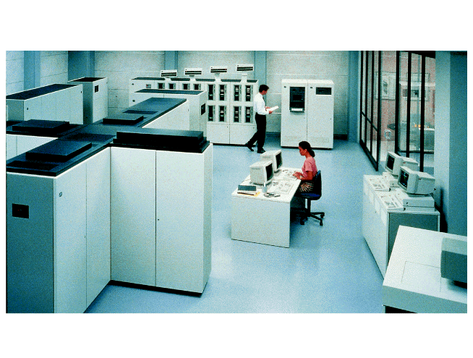
Mainframe Computers

Slide 29
First computers, introduced in 1950s
Used by large businesses
Typically supported 100 to 500 users
Very expensive
Used for very large processing tasks
These days, mainframes are not so much defined by computational speed as by redundant internal engineering and resulting high reliability.
Also feature security, extensive input-output facilities, strict backward compatibility with older software, and high utilisation rates to support massive throughput

Slide 30
Often run for years without interruption
Repairs and upgrades taking place during normal operation
Typical application includes:
Large corporate data processing
Census processing

Slide 31
Mini Computers
Mid-range computer systems, traditionally between Mainframes and Micros.
Significant overlap between high end PC, workstation, server and mini computer
Current systems by Sun, IBM, Hewlett-Packard etc.
Most commonly use Unix operating system
DEC PDP-8
First commercially successful mini
Introduced 1965
Last produced 1979
Typically supported 10 to 100 users
Smaller and less expensive than mainframes
The real difference is relative in terms of price, power, marketing.

Slide 32
Microcomputer (Personal Computer
Small, self-contained computers with their own CPUs
Used by home and business users
Uses a microprocessor, a CPU (Central Processing Unit) on a single chip.
Now generally called PCs and using the industry standard Intel x86 compatible architecture and usually Microsoft Windows operating system
Launched 1981
Used Intel 8088 micro-processor
16 bit internally but 8 bit externally to keep cost of other components (particularly memory) down
Basis of current x86 architecture

Slide 33
Laptop Computers
A full computer system in a single case
Easily portable
Can run off batteries or mains electricity
Screen opens up to reveal keyboard
Vary from light weight, small screen and keyboard (often called Netbook) to large, heavy desktop PC replacements
Usually using Intel x86 and Windows

Slide 34
Other Types of Computer
Server
Generally PC architecture, often with multiple CPUs, lots of memory and big disks
Deliver service such as file and print sharing, or web servers
Personal Digital Assistant (PDA)
Very small, to fit in a pocket
Often touch screen
An electronic version of a diary and address book
Generally being replaced by…

Slide 35
Smart Phone
An example of digital convergence
Mobile phone, MP3 player and PDA functionality in one pocket sized device
May include camera and other facilities as well
Tablet PC
Like a laptop or Netbook but with a touch screen that you can write on

Slide 36
Embedded Systems
Computers are now built into many devices.
Embedded computers are computers found in consumer goods in order to enhance their function
Cars have computer controlled engine management systems.
Digital televisions and personal video recorders are effectively computers.
Factory machinery is computer controlled.
Etc. etc. etc.

Slide 37
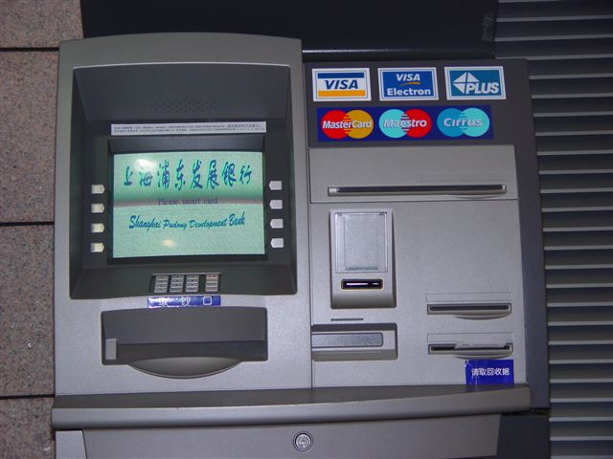
Special Purpose Computers
Special purpose or dedicated computers – A device with a specific purpose such as game system or information kiosk.

Slide 38
Hardware versus Software
Hardware = The physical components that make up a computer system.
Software = The programs (instructions) that tell the computer what to do.
System Software
Application Software
Stored on a storage media such as hard disk, CD-ROM, floppy disk, tape, etc.

Slide 39
Basic Computer Architecture
The vast majority of computer systems are made up of a standard set of functional devices, connected together in a standard way.
This is generally called the “Von Neumann” architecture after the man who first documented it.
However, Von Neumann did not invent it – but J. Presper Eckert and John Mauchly, who were developing the ENIAC at the Moore School of Electrical Engineering, at the University of Pennsylvania, did most of the work.
There were other researchers in other countries also developed most of the concepts independently.

Slide 40
Von Neumann Architecture
Memory
Backing
Storage
(not always
included at this level)
Control Unit
Arithmetic Logic Unit (ALU)
Accumulator
Input
Output

Slide 41
Central Processing Unit (CPU)
There is some discussion over what is included in the CPU.
ALU – definitely
Control Unit – definitely
Memory or primary storage – depends on who you ask and your definition of memory
The term CPU is often used synonymously with “processor” and refers to the microprocessor at the heart of the system, e.g. an Intel i7 processor.
Which has ALU, control unit, and some cache memory on board
But…does not include main memory (RAM)

Slide 42
Better to define what a CPU does:
The CPU is the part of a computer that carries out programmed instructions.
The CPU controls the rest of the computer system, including main memory (RAM), secondary or backing storage (e.g. hard disk), input and output devices.

Slide 43
Parts of the CPU –ALU
Arithmetic Logic Unit
Performs arithmetic and logical operations
Always addition and negation of integers
May include multiplication
Otherwise does repeated addition
Does not do subtraction
Does negation and then addition instead
May do division
Or repeated subtraction instead
May do floating point numbers as well
Also does AND, OR, NOT and possible XOR
Largely defines the rest of the CPU’s architecture

Slide 44
Control Unit
Handles the instructions contained in the program
In general, the input is the next instruction.
The outputs are control signals to other parts of the CPU or the rest of the computer.

Slide 45
Memory
It is necessary to store (or remember) programs and data, both whilst they are in use and over longer periods.
Two broad classifications of memory:
Primary Storage
Secondary Storage
Historical note: Check on the web for information on previous storage technology, including magnetic drums, floppy disks and core storage.

Slide 46
Primary Storage –RAM Technology
Also called main memory
Currently implemented as solid state (i.e. electronic) random access memory (RAM)
(Aside: Look up previous types of primary storage, e.g. core store)
RAM is fast, small with low power consumption, but relatively expensive (cost per bit) and volatile (forgets when switched off).

Slide 47
Two basic technologies:
Static RAM – uses a flip flop circuit and remembers as long as it has power but costs more
Dynamic RAM – uses a capacitor to hold charge, which leaks out so needs refreshing but costs less
Most PC systems (& games consoles etc) use dynamic RAM because of cost.
Modern PCs may have multiple Gigabytes (GB) of RAM in a small number of chips mounted on a circuit board package called a dual in-line memory module (DIMM) which mount in slots on the motherboard.
Variations exist, such as single in-line memory module (SIMM)

Slide 48
Primary Storage –ROM
Read Only Memory
A variation on main memory
The data or program is built into the chips when they are made and cannot be changed.
Non-volatile
Used for code that does not change, such as PC BIOS
This kind of memory is called volatile because it is temporary in nature. By contrast, another kind of memory called non-volatile memory, holds its data permanently, even when the power is turned off. Non-volatile memory is used in flash drives, memory cards, and some types of hard drives.

Slide 49
ROM Variations
PROM – programmable ROM – made as a “blank” which can then be programmed once or “burned” (after which it can not be changed).
EPROM – Erasable PROM – made blank, programmed like PROM but can be erased (blanked) usually using UV light.
EEPROM – Electrically Erasable PROM – usually read only, but can be erased and re-written. This is very slow compared with normal RAM and there is a limit to the number of cycles (changes) that can be made before the unit fails. It is useful for configuration settings which do not change very often.
Flash Memory – a variation of EEPROM that can be changed more easily and quickly – has a much higher cycle limit (currently about 1 million cycles) – used in cameras, PDAs, MP3 players and USB flash drives (memory sticks) etc.

Slide 50
Four Major Types of Computer Memory
DRAM
SRAM
ROM
COMOS

Slide 51
DRAM
This is Dynamic random Access Memory and is used to expand the memory in the computer to improve processing speed.
It is cheap compared to other types because they are less complex.
It needs to be refreshed often times.

Slide 52
SDRAM

Slide 53
Secondary Storage – Hard Disk
Also called backing store
Most commonly implemented as hard disk drive
Other variations on this next slide
Non-volatile, low cost per bit, high power consumption, many times slower than RAM

Slide 54
Secondary Storage – Interfaces
Integrated Drive Electronics (IDE)
This was the original name for this interface
Later it became known as ATA
The first two letters (AT) came from IBM PC/AT and stood for Advanced Technology
The other A stands for attachment
Now called Parallel ATA (PATA) to distinguish from SATA
Introduced 1986, obsolete through the introduction of SATA in 2003
Used a 40 (or later 80) wire parallel ribbon cable.

Slide 55
Serial ATA (SATA)
Launched in 2003
Now the standard in PCs
reduced cable-bulk and cost (7 conductors versus 40), native hot swapping, faster data transfer through higher signalling rates, more efficient transfer through an (optional) I/O queuing protocol

Slide 56
Motherboard
This is the main circuit board of the PC
Usually mounted on the bottom of the case (desktop cases) or vertically (tower cases)
Has slots for processor, memory and expansion cards
Has connectors for secondary storage (SATA these days), power, USB, case switches and lights etc.
Motherboards are available in a number of “standard” sizes which will fit most PC cases
The motherboard contains a socket to hold the CPU; the CPU is the component in which most processing takes place.
The motherboard is the most complicated piece of equipment inside the case, because all devices must communicate with the CPU installed on the motherboard,
All devices in a computer are either installed directly on the motherboard, directly linked to it by a cable connected to a port on the motherboard, or indirectly linked to it by expansion cards.
A device that is not installed directly on the motherboard is called a peripheral device.

Slide 57
North Gate vs. South Gate
They are the chipset. The north bridge is the main system bus, the main peripheral bus controller, and often the memory controller and even integrated graphics or AGP controller in some cases.
The south bridge controls peripherals and things closer to the user, ranging from the ROM BIOS, the mouse, the keyboard, disk controller, sound controller, USB and more.

Slide 58
Components that allow the processor to communicate with other devices are as follows:
Traces, or wires, on the motherboard used for communication
Expansion slots to connect expansion cards to the motherboard
The system clock that keeps communication in sync
Connections for data cables to devices inside the case
Ports for devices outside the case.

Slide 59
Chip Set
The supporting electronics on the motherboard is known as the Chip Set
Northbridge
Typically handles faster communications between CPU, RAM, and PCI Express (or AGP) video cards, and the southbridge
Some contain integrated video controllers
Southbridge
Typically handles slower communications to SATA, audio, USB, network etc.
Possibly graphics and sound in separate chips
Exact content of motherboard and chip set depends on the processor(s) it supports
Memory controllers are now usually on the processor
Intel launched the “Sandy Bridge” version of its Core processor range in January 2011, which includes on-chip graphics.

Slide 60
The processor could not do its job without the assistance of the chipset, a group of microchips on the motherboard that control the flow of data and instructions to and from the processor.
The chipset is responsible for the careful timing and coordination of activities.
The chipset is an integrated component of the motherboard and is contained in two packages embedded on the motherboard.

Slide 61
Power Supply (PSU)
All PCs need power.
Usually comes from mains electricity or battery (laptops etc.)
Most modern power supplies will detect input voltage.
Better supplies have modular cable systems, allowing you to just use the cables you need.
Make sure that your PSU has the correct connectors for your motherboard and disk drives.
Some graphics cards also need a direct power connection.

Slide 62
The most important component of the computer’s electrical system is the power supply, which is usually near the rear of the case.
This power supply does not actually generate electricity but converts and reduces it to a voltage that the computer can handle.
A power supply receives 110–120 volts of AC power from a wall outlet and converts it to a much lower DC voltage. Older power supplies had power cables that provided either 5 or 12 volts DC.

Slide 63
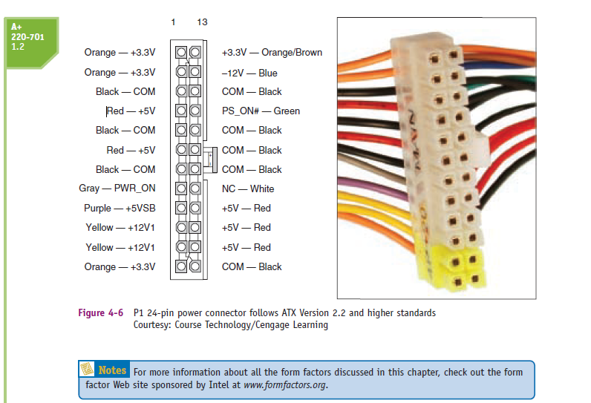

Slide 64
Standard Power Supply Connectors
Molex: for connecting Hard disk or CD-ROMs drives.
Berg Connectors- for connecting floppy disk drives
P1 connector for connecting power source to the mother board.

Slide 65
TYPES OF FORM FACTORS
When selecting a computer case, motherboard, and power supply, chooses a design that fits its intended use.
For instance, you might find that you need a high-end tower system, a rack-mounted server, or a low-profile desktop.
When you understand the intended use, you then can decide which form factor you will use.

Slide 66
